Slide 1
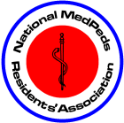
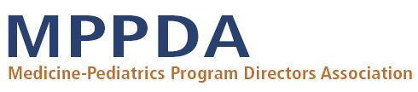

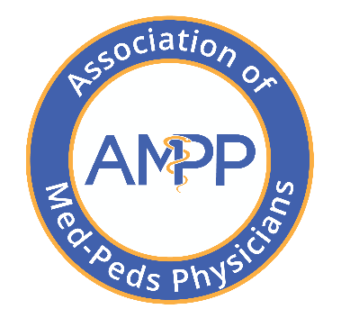
Combined
Internal Medicine - Pediatrics
Med-Peds
Versatile training for the 21st century physician
Notes:
Thank you for inviting me (us) to your school to talk about med-peds. Today I (we) will expose you to a unique field of medicine that has 40 years of history with enormous richness. Our field has the ability to sustain itself and you through the 21st century while the medical landscape changes. This slide show is not all encompassing. I (We) have found that many of you have heard very little or have been provided with minimal information about this potential career path.
I (we) am…. Give bio (medical school and residency training and briefly what you do now e.g. what type of practice, who do you work with, how many per week do you work).

Slide 2

Let’s Get Basic
Internship
  The first year out of medical school = The first year of residency = Post Graduate Year 1 (PGY-1)
Residency
  Depending on the specialty can be from 1 – 7 years in duration = Post Graduate Years 1 – 7
Combined specialties
  Two or more residency specialties offered together: med-peds, internal medicine-emergency medicine, pediatrics-psychiatry-child & adolescent psychiatry
Fellowship
  A physician may also choose to continue their training for a sub-specialty such as cardiology, critical care, pediatric emergency medicine, geriatrics, bariatric surgery, adolescent gynecology
Notes:
Many of you are early in your medical school training and may not know what exactly residency training is. After completion of medical school you become a doctor but really you are not equipped to practice medicine or even get a state license to practice medicine. Residency training is what comes after medical school with your first year of residency called internship. You apply to residency training programs in your 4th year of medical school through a “matching” process.

Slide 3
Residency Programs: Dec 2024
Program Type | Number Programs | Approximate # Residents | Duration
Pediatrics | 219 | 9,488 | 3 years
Internal Medicine | 686 | 32,912 | 3 years
Med-Peds Combined specialty | 78 | 1,550 | 4 years not 6 years
Family Medicine | 819 | 15,221 | 3 years
Obstetrics-Gynecology | 304 | 5,996 | 4 years
General Surgery | 368 | 10,741 | 5 years
Notes:
Med-Peds physicians complete a 4-year residency program combining two residencies - Internal Medicine and Pediatrics. Over the 4 years, 24 months of training are received in each specialty but it is integrated. After the 4 years we are board eligible in both Internal Medicine and Pediatrics through the American Board of Internal Medicine (ABIM) and the American Board of Pediatrics (ABP). Our component residency programs (Internal Medicine and Pediatrics) each take 3 years to complete but because of the overlap in knowledge base and approach to patients, both are able to be completed in just 4 years. As you can see we are small subset of the workforce but have growing pivotal roles in many hospital and practice systems.

Slide 4


Who We Are As Med-Peds
Pediatricians are specialists for children
Internists are
specialists for adults
As Med-Peds physicians we provide care in two specialties,
complete two type residency programs,
take two separate Board Certifications (Internal Medicine & Pediatrics),
care for two groups of people
As Med-Peds physicians we are specialists for a population
Notes:
We are doctors that trained in two specialties, two residency programs combined for two separate Board Certifications (Internal Medicine and Pediatrics) that take care of two populations of people. Yes, you must like to care for both adults and children to “get the most” out of med-peds.
We enjoy a breath of and depth of knowledge in both these disciplines through integrated residency training. We have the ability to care for all individuals young and old (like these pictures depict) with comfort and confidence. We bring a unique insight to the care of patients throughout the life-span.

Slide 5
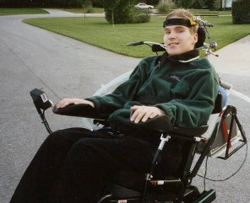

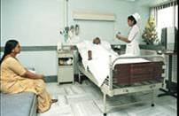
The Versatile Med-Peds Physician
Treat/prevent common diseases
Survivors of chronic health conditions
We draw from the skills and abilities of internists & pediatricians to care for individuals and generations of families
Flexibility and versatility are synonymous with Med-Peds
Graduates follow many careers paths that can change over time
Global Health

Slide 6



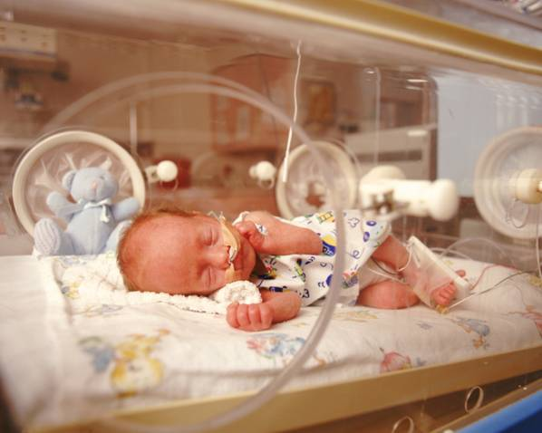
The Versatile Med-Peds Physician
Preventative care for families
Rural settings
Can you imagine anyone better prepared than a med-peds physician for these patients?
You can choose from primary care, hospital care and subspecialty care or some combination
We are able to tailor our practices to what the community, individual and your needs
Adolescents have unique needs
ICU settings

Slide 7

Unique Characteristics of
Internal Medicine-Pediatrics
4 year integrated residency program of 2 primary care specialties
It is the first combined specialty approved by any Board (1967) & the only accredited combined specialty by the Accreditation Council of Graduate Medical Education (2007) & also has the most combined residents (~1500) and graduates (~9000)
All 4 years of training are fully funded by CMS under President Clinton Balanced Budget Act (BBA of 1997) http://www.gpo.gov/fdsys/pkg/PLAW-105publ33/html/PLAW-105publ33.htm
Notes:
Med-Peds was developed after 3 national reports recommended changes in primary care education and certification, the perfect generalist.
The concept of combined training in Internal Medicine and Pediatrics (Med-Peds) had its origins from 1949 to 1961 in the form of a two-year rotating internship. Although, initially successful, the program gradually lost faculty and resident support and was replaced by one year post graduate options combining Medicine-Pediatrics, Medicine-Surgery, and Medicine-OB/GYN. The two latter programs (Med-Surg and Med-OB/GYN) were discontinued in the late 1960s because of lack of student and faculty support. In contrast, faculty, resident, and medical student interest in combined Internal Medicine-Pediatrics training remained. It flourished following endorsement in 1967 by the ABIM and the ABP of the concept of combined training leading to dual Board eligibility.
Prior to 1967, there were no comprehensive programs that spanned the ages. The same year that Med-Peds was approved, a three-year general practice curriculum was created that ultimately became family practice.
Internal Medicine-Pediatrics (Med-Peds), began in a couple of programs in 1967. Though their format was different than today, they paved the way for the huge growth in our field.

Slide 8
Unique Characteristics of
Internal Medicine-Pediatrics
The “perfect double major” to serve age continuum, in/outpatient settings, cross fertilization, versatility and special niches (e.gs. transition and global health)
Two years of pediatrics training included
Many graduates are in outpatient practices but also many care for hospitalized patients and become a hospitalist or specialize in any pediatric and medicine fellowship
Notes:
Med-Peds was developed after 3 national reports recommended changes in primary care education and certification, the perfect generalist.
The concept of combined training in Internal Medicine and Pediatrics (Med-Peds) had its origins from 1949 to 1961 in the form of a two-year rotating internship. Although, initially successful, the program gradually lost faculty and resident support and was replaced by one year post graduate options combining Medicine-Pediatrics, Medicine-Surgery, and Medicine-OB/GYN. The two latter programs (Med-Surg and Med-OB/GYN) were discontinued in the late 1960s because of lack of student and faculty support. In contrast, faculty, resident, and medical student interest in combined Internal Medicine-Pediatrics training remained. It flourished following endorsement in 1967 by the ABIM and the ABP of the concept of combined training leading to dual Board eligibility.
Prior to 1967, there were no comprehensive programs that spanned the ages. The same year that Med-Peds was approved, a three-year general practice curriculum was created that ultimately became family practice.
Internal Medicine-Pediatrics (Med-Peds), began in a couple of programs in 1967. Though their format was different than today, they paved the way for the huge growth in our field.

Slide 9
Med-Peds Requirements
Med-Peds Educational Activities
Resident Practice
Transitions
General Medicine and General Pediatrics
ICU Time
Subspecialty Rotations
Rotate every 1-6 rotations between specialties
Plenty of general medicine and pediatrics inpatient and outpatient rotations in different settings (outpatient and inpatient)
Limited to 8 months (minimum 2 months each in IM and Peds) in NICU, PICU, CICU and MICU
IM: Experiences in each IM specialty to also include geriatrics, hospice and palliative, addiction medicine, emergency medicine and neurology
Journal clubs, business meetings, conferences and other times just for med-peds residents. Can include research, transition care, global health
Have a panel of continuity patients for each med-peds resident
Peds: Experiences in adolescent medicine, development-behavioral, peds mental health, inpatient and outpatient specialty care
ACGME Program Requirements for Graduate Medical Education in Internal Medicine-Pediatrics. 2026
Notes:
Requirements for med-peds programs were created in 2006 with multiple areas of focus and ACGME accreditation of programs since 2007. Latest update 2026.

Slide 10
Med-Peds Requirements/Limits
Internal Medicine | Number of months | Pediatrics | Number of months
Inpatient Medicine (includes floors, specialty, ICU) | 8 | Inpatient Pediatrics | 5
Medical Intensive Care Unit | 1-2 | Pediatric Intensive Care Unit | 1
Cardiac Intensive Care Unit | 1-2 | Neonatal Intensive Care Unit | 1
Geriatrics and Neurology | 1-2 | Newborn Nursery | 1
Emergency Medicine | 1 | Emergency Pediatrics, Community Pediatrics and Advocacy | 4
Night Float (maximum) | 2 | Behavioral-Developmental and Adolescent Medicine, Mental Health | 3
Subspecialty experience (e.g. Infectious Diseases, Nephrology, etc.) | 4 + | Subspecialty experience (eg. Infectious Diseases, Nephrology, etc.) and personalized rotations | 6 +
 |  | Personalized
Outpatient Med-Peds continuity |  |  | 36 + clinics per year or X + Y
Overall Ambulatory Experience (minimum) | > 40% 8 months + | Overall Ambulatory Experience (minimum) | > 40% 8 months +
Notes:
Here is a general schematic of required rotations in med-peds based on the requirements. It incorporates a broad base of primary care thru tertiary care, ambulatory and hospital work.

Slide 11
The Changing Landscape
“People with the broadest perspective and the most comprehensive knowledge will lead the transformation in health care”
Dr. Dale Vidal- Dartmouth Health Care Delivery Masters Program 2014
Pediatric survivors now adults
  Congenital heart disease
  Cystic fibrosis
  Sickle cell disease
  Cancer
  Spina Bifida
Adult disorders in children
  Diabetes
  Obesity
  Hypertension
  Sleep apnea
  Hyperlipidemia
People are surviving conditions that were once fatal in childhood. As well, illnesses that used to be seen only in adults are becoming epidemic in children

Slide 12
Fellowships After Med-Peds
Can do an adult fellowship, pediatric fellowship or combined (adult-pediatric) fellowship
Some examples
Adolescent Medicine
Allergy-Immunology
Cardiology (general, interventional adult congenital heart disease, electrophysiology)
Child Abuse
Critical Care (MICU, PICU)
Developmental-Behavioral
Endocrinology
Gastroenterology
Genetics
Geriatrics
Hematology-Oncology
Hospice and Palliative Care
Infectious Diseases
Medical Informatics
Nephrology
Neurodevelopmental Pediatrics
Pediatric Emergency Medicine
Perinatology
Pulmonary
Rheumatology
Sleep Medicine
Sports Medicine
Toxicology
Transplant Hepatology
Weight Management
Notes:
There is not another residency that opens as many doors as med-peds

Slide 13
Med-Peds Resident Distribution
On Duty December 31, 2024

Slide 14
Med-Peds Gender Distribution
On Duty December 31, 2024

Slide 15
How it All Fits Together
Learn both
Complete both
Practice both
Pass both

Slide 16
It is Possible to Complete Both
Notes:
There is a high completion rate considering it is a combined program. This is comparable to other residency programs.

Slide 17
It is Possible to Learn Both
HOW IS IT POSSIBLE TO LEARN TWO DISCIPLINES?
Fundamental clinical skills in common: (history and physical, communication, organization)
Advanced clinical skills in common: (information processing, reasoning, hypothesis testing, deduction, epidemiology)
Some differences: manifestations/incidence of same conditions at different ages, nuances of treatment, neonatology and first two years of life
Notes:
HOW IS IT POSSIBLE TO LEARN TWO DISCIPLINES?
At first glance, the concept of training in two broad and deep disciplines such as pediatrics and internal medicine can seem daunting. Though rigorous, many similarities exist between the two areas. Fundamental clinical skills are similar in the two disciplines. Though it requires special skills honed with practice to adeptly acquire a good history and perform a physical exam, there are similarities across age groups, communication skills are core, and the organization of information recording is fairly uniform. Advanced clinical skills -- those reflecting information processing, reasoning, hypothesis testing, deduction, applied statistics, and epidemiology -- are fundamentally the same in the two specialties. Pathophysiology is more similar than dissimilar across the disciplines, with the biggest difference being the manifestations of the same condition at different ages, the incidence/prevalence of conditions at different ages, and some nuances in treatments at different ages.
Learning weight-based pediatric pharmacology and fluid therapy can make adult pharmacology and fluid therapy simpler, though the range of commonly used drugs is broader as patients age. There are clear areas of physiologic overlap in adolescence. The fundamentals of performing and interpreting a developmental evaluation are similar in pediatrics and geriatrics.
There are subspecialty areas, such as infectious disease, with a substantial range of diseases that are more similar than dissimilar in the two disciplines. The principles of preventive health care are similar, particularly from a systems/process perspective, though the focus and specifics are different. There is no better way to appreciate the impact of illness on a family than to take care of the whole family.
There are areas that are fairly unique and overlap less. Paramount among them on the pediatric side is neonatology and the first two years of life in general. Some mastery in those areas fortunately comes from the intensity of the exposure to patients of that age on any pediatric service. On the adult side, areas of less overlap include coronary artery disease, cerebrovascular disease, lipid disorders, Type II diabetes (until recently), and other inpatient-intense diseases. Oncology is quite different in the two disciplines, but the primary care physician's role remains similar across the age spectrum.
Achieving the greatest competence in any discipline begins with learning from those who have mastered it. Pediatricians and internists are those masters. They have defined the care of children and adults through decades of research synthesized into a meaningful whole. They have developed cogent guides for application of this wealth of information and practical tools for its implementation. They model relentless advocacy promoting its utilization to optimize the care of patients across the age spectrum.
Growth in competence stems from partnership with masters throughout one's career, a characteristic of internists, pediatricians, and Med-Peds physicians that facilitates the exploration of new frontiers and the osmosis of new developments. Mastery by the learner evolves from continued nurturing through access to the highest quality continuing medical education. The general and subspecialty societies of pediatricians and internists are without peer in the world of medicine. They support a rich network that promotes partnership, collaboration, and growth throughout their careers amongst physicians of like mind.

Slide 18
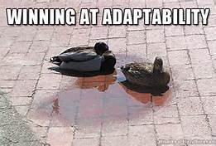
Why Learn Both?
Comprehensive view of health and illness
  The most complicated patients will still need to be managed/led by physicians in outpatient and inpatient settings
  Know and see as much of health system(s) to bring the proper perspective through the depth and breadth of clinical training across different departments, service lines and systems
  Critical and sophistication of thinking so to not consult everyone
“Adaptable” the ability to change (or be changed) to fit changing circumstances
“Flexible” the ability to cope with variable circumstances
“Versatile” having a wide variety of skills
Cross fertilization of ideas for system wide improvement
Clinical Relevance
Niches
Notes:
Let us imagine what we need in graduate medical education
We need graduates that have some of the most comprehensive view of health and illness. Some of this comes through Med-Peds training. You see almost every part of the health system and setting
The four years of integrated training allows graduates to provide the depth and breadth and the clinical view needed to be on the front lines of population health. The most complicated of patients (the most expensive to manage) will still need to managed by physicians in the future, so sophistication and critical thinking of the primary care physician and hospitalist is critical as to reduce unnecessary consultations and testing. The ability to provide family care will be more important in the future in order to address many of the determinants of health (genetics and behavior) as we get away from providing care on an individual’s risk assessment.
The hospitalists that see more of the entire system will be some of the best people to focus on quality care, hospital wide system improvement and health system efficiency through cross fertilization of ideas from department to department or service line to another service line.

Slide 19

It is Possible to Practice Both
About 50-60% of graduates go into primary care practice. The majority (between 77-93%) provide care for both adults and children.
  40% also have an academic appointment with a medical school
About 18-25% of graduates pursue fellowship and 50% provide care for both adults and children.
  60% also have an academic appointment with a medical school

Slide 20
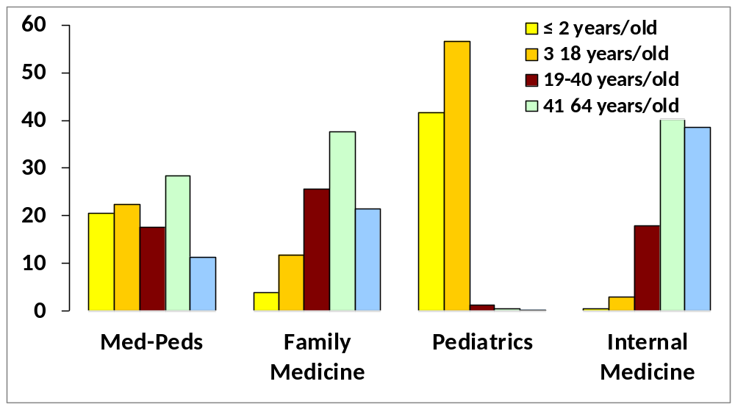
It is Possible to Practice Both
Age Distribution (percentages) of Patient Visits to Primary Care Providers Recorded in the National Ambulatory Medical Care Survey from 2000-2006
43% children
15% children
% visits
Fortuna, Ting, Kaelber and Simon. Characteristics of Medicine-Pediatrics Practices. Academic Medicine (84) 3; March 2009: 396-401

Slide 21
Well Trained to Practice
Inpatient Care
18-25% of recent Med-Peds graduates are hospitalists
Many provide care to adults who survived congenital & child onset conditions
40% of hospitalist internists do not feel comfortable caring for adults with child onset conditions but had to care for this group of patients anyway
    …….but a med-peds hospitalist would feel comfortable
Notes:
Since most ambulatory physicians do not care for their hospitalized patients, it is critical to have a strong base of hospitalists that understand the outpatient setting as well. Hospitalists also provide some ambulatory care (e.g. discharge clinics). Practice mix may vary significantly based upon regional need.

Slide 22
It is Possible to Pass Both
Board Pass Rate (2010-2025)
American Board of Internal Medicine
&
American Board of Pediatrics
  The pass rate for med-peds graduates is statistically equivalent to categorical residents

Slide 23
Impact of Med-Peds on Pediatrics
60% of graduating pediatrics residents said that combined programs enhanced their education, 39% no effect, only 1% negative impact
Friedland A, Melgar T, Kaelber D, Cull W, Chamberlain J, Kan B. Impact of combined pediatric residency training programs on the educational experience of the categorical pediatric residents. Association Pediatric Program Directors Annual Meeting, Poster Presentation 2009
Pediatric residency programs with combined Med-Peds programs did better on pediatrics boards
Falcone JL. Residencies with Dual Internal Medicine and Pediatrics Programs Outperforms Others on the American Board of Pediatrics Certifying Exam. Clinical Pediatrics. 2014 May 6;53(9):854-857

Slide 24
“It not possible to determine the future shape of health care delivery and to project the workforce needed; therefore, the maximization of provider career flexibility will be crucial”
Nasca and Thomas. Medicine in 2035: Selected Insight from ACGME Scenario Planning. Journal of Graduate Medical Education. March 2015
“Med-Peds graduates are well positioned to adapt to a changing medical landscape”
Frohna J. The Role of the Med-Peds Physician in a Changing Medical World. J of Pediatrics. 2007;151:338-339.

Slide 25

The Future of Med-Peds is Bright

Slide 26
Why Do Medical Students
Chose Med-Peds?
Age spectrum
Variety & depth of training
Liked both
Flexible career
Primary care focus
Ability to specialize
Role models
Did not want OB/Surg
Transition & adolescent
More Pediatrics
Notes:
This was a survey of those that applied to at least one Med-Peds program. These were the top ten reasons why students choose Med-Peds
345 surveys sent with 52% (168) response rate.

Slide 27

Fourth Year Electives
Many Types of Electives
  Med-Peds specific electives
    Settings: Inpatient, outpatient, both
    Types: Primary care, specialty, hospitalist, combination
    Can help a student decide if med-peds is for them, role modeling, career paths
  Categorical Electives in Pediatrics or Internal Medicine
    Get on a team with a med-peds resident or attending
    Try to arrange to participate in med-peds activities anyway during the elective
    Get to know the hospital system , career paths

Slide 28
Summary of Med-Peds
Depth and breadth of two disciplines that allows flexible career goals without Surgery and OB training. The perfect “double major”
Four years of training that is rigorous but humane; gives added maturity to your career
Wide variety of practice styles and settings; effective with variety of patient problems
Dual board certification in Internal Medicine and Pediatrics that is unique
Niches of special populations; cross fertilization of knowledge
55 years of rich history in Med-Peds
Visit NMPRA - The National Med-Peds Residents Association | A resident led association of Internal Medicine-Pediatrics residency programs& About the AAP Section on Combined Internal Medicine and Pediatrics (SOMP)
Notes:
As a summary:
We believe Med-Peds has:
The depth and breadth of two disciplines that allows flexible career goals without Surgery and OB training. The perfect “double major”.
There is four years of training that is rigorous but humane; gives added maturity to your career (think of it as 6 years minus 2)
A wide variety of practice styles and settings for an effective career
Obtaining dual board certification in Internal Medicine and Pediatrics that is still quite unique
There are niches of special populations and cross fertilization of knowledge
Almost 60 years of rich history in Med-Peds
Thank you. I would like to entertain any more questions.

